Slide 1
Colour me decimals
We are learning to recognise that the place value system can be extended to tenths, hundredths and thousandthsand using decimats to help us.

Slide 2
One Unit = 1

Slide 3

Broken into ten parts
What is each part worth?
$$\frac{1}{10}$$

Slide 4

$$\frac{1}{100}$$
$\frac{1}{10}$ broken into ten parts
How many smaller pieces in the whole rectangle?

Slide 5

$$\frac{1}{1000}$$
$\frac{1}{100}$ broken into ten parts
What fraction is each part?

Slide 6
What’s another way of saying $\frac{1}{10}$?
0.1

Slide 7
What would the shaded region be as a decimal?
0.5

Slide 8
How can we write $\frac{2}{100}$as a decimal?
0.02

Slide 9
How can we write $\frac{7}{1000}$ as a decimal?

Slide 10
What about 0.25?

Slide 11
What about 0.136?

Slide 12
Decimats Game
Shade the greatest region possible to beat your opponent

Slide 13
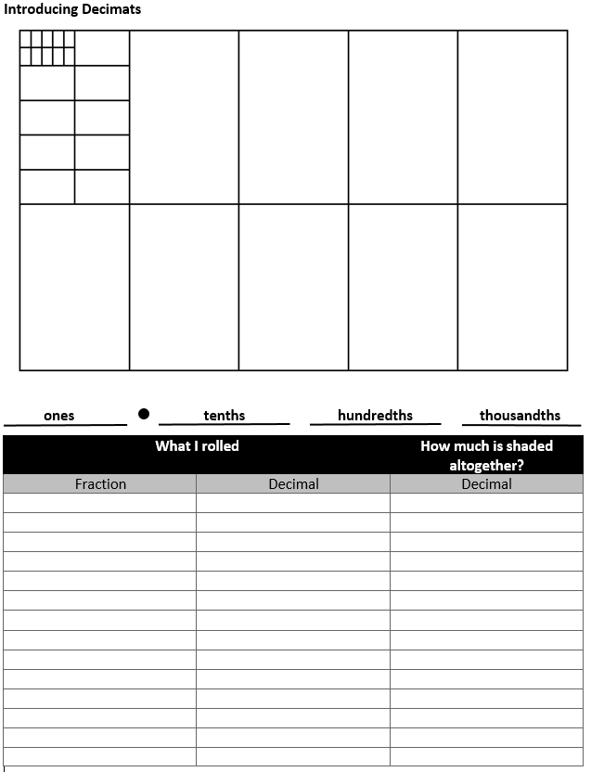
Decimats Game
Shade the greatest region possible to beat your opponent

