Slide 1
GEOMETRY
Janine McIntosh janine@amsi.org.au
Michael O’Connor: moconnor@amsi.org.au

Slide 2
The Improving Mathematics Education in Schools (TIMES) Project
The Versatile Circle
A conversation about the properties of 2D shapes and 3D objects
With thanks to Peter Carmichael, Principal Project Officer - QCAR Mathematics, Nambour

Slide 3
Geometry
Geometry 4 - 9
Arithmetic has numbers as its basic object of study, in plane geometry points, lines and circles are the basic building blocks. Geometry is used to model the world around us. Classifying and studying the properties of geometric objects gives students an opportunity to develop geometric intuition and also to learn how to construct logical arguments and make deductions in a setting which is, for the most part, independent of number. In this session we will take a look at the rich history of geometry, investigate some ways to develop ideas with children and and link to some classroom activities.

Slide 4
Space = Geometry

Slide 5
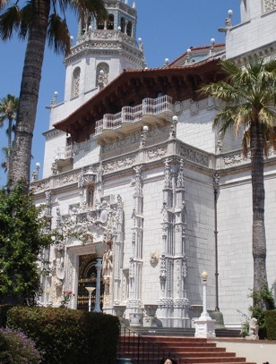
Space
The mathematical study of space is called geometry
Geo: “earth”
-metry: “measure”

Slide 6
Space
Emphasis is on making links between two-dimensional shapes and three-dimensional objects in the physical world and their abstract geometrical representations, leading to an understanding of their properties and how they can be used to solve practical or aesthetic problems

Slide 7
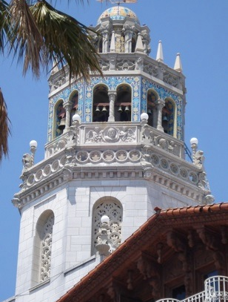
Space
The study of space is an important part of school mathematics because:
we use spatial ideas for a wide variety of practical tasks
spatial ideas are basic to the solution of many design problems

Slide 8
Geometry
Prior knowledge
• The use of compasses and rulers and the careful drawing of geometrical figures.
• Types of angles, including at least right angles, acute angles, obtuse angles and reflex angles.
• Triangles, including an informal introduction to isosceles and equilateral triangles.
• Quadrilaterals, including an informal introduction to squares, rectangles, parallelograms, trapezia and rhombuses.
• Informal experience with translations, reflections, rotations and enlargements, and with symmetry in the context of activities such as folding an isosceles triangle, rectangle or rhombus.

Slide 9
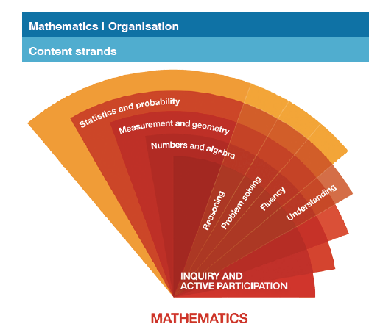
Fractions
Australian Curriculum
What does the Australian Curriculum say?

Slide 10
Geometry in Geometry and Measurement
Year 4 CD1. Geometry
Generalise about the two-dimensional shapes that form the surfaces of common three dimensional objects and make connections with the nets of these objects justifying reasoning
Year 4 CD5. Angle
Describe the connection between turns and angles and create and classify angles as equal to, greater than or less than a right angle
Year 5 CD1. Geometry
Make connections between different types of triangles and quadrilaterals using their features, including symmetry and explain reasoning
Year 6 CD1. Geometry
Visualise and solve problems relating to packing and stacking
Year 7 CD1. Geometry
Describe the properties of parallel and perpendicular lines, triangles and quadrilaterals to classify them and make geometric constructions including angle bisectors and perpendicular bisectors

Slide 11
Angle in Geometry and Measurement
Year 4 CD5. Angle
Describe the connection between turns and angles and create and classify angles as equal to, greater than or less than a right angle
Year 6 CD4. Angles
Estimate, compare and measure angles
Year 7 CD1. Geometry
Describe the properties of parallel and perpendicular lines, triangles and quadrilaterals to classify them and make geometric constructions including angle bisectors and perpendicular bisectors

Slide 12
Transformations in Geometry and Measurement
Year 5 CD 5. Transformations
Visualise, demonstrate and describe the effects of translations, reflections, and rotations of two-dimensional shapes and describe line and simple rotational symmetry, including using ICT
Year 6 CD7. Transformation and symmetry
Describe patterns in terms of reflection and rotational symmetry, and translations including identifying equivalent transformations using ICT
Year 7 CD 3. Transformations
Visualise, demonstrate and describe translations, reflections, rotations and symmetry in the plane, including using coordinates and ICT

Slide 13
Geometry in Geometry and Measurement
Year 8 CD1. Congruence
Identify properties and conditions for congruence of plane figures, and use coordinates to describe transformations
Year 8 CD2. Measurement formulas
Generalise from the formulas for perimeter and area of triangles and rectangles to investigate relationships between the perimeter and area of special quadrilaterals and volumes of triangular prisms and use these to solve problems
Year 8 CD3. Circles
Investigate the relationship between features of circles such as circumference, area, radius and diameter and generalise these to solve problems involving circumference and area
Year 8 CD4. Congruence
Explain properties for congruence of triangles and apply these to investigate properties of quadrilaterals

Slide 14
Geometry in Geometry and Measurement
Year 9CD1. Geometry
Investigate properties of polygons and circles, including lines and angles, forming generalisations, explaining reasoning and solving problems
Year 9 CD2. Pythagoras
Solve problems involving right angled triangles using Pythagoras’ theorem and trigonometric ratios and justify reasoning
Year 9 CD3. Similarity
Apply transformations to triangles to explain similarity and congruence, to establish geometric properties
Year 9 CD4. Circles
Solve problems involving circumference and area of circles and part circles, and the surface area and volume of cylinders and composite solids

Slide 15
Geometry
Why teach it?
Just as arithmetic has numbers as its basic object of study, so points, lines and circles are the basic building blocks of plane geometry.
Geometry gives an opportunity for students to develop their geometric intuition, which has applications in many areas of life, and also to learn how to construct logical arguments and make deductions in a setting which is, for the most part, independent of number.

Slide 16
Why teach it?
Why teach geometry?
Applications
Accessibility to students who prefer pictures
Encourages flexibility
Historical importance
Central role in mathematics
Logical structure
The surprise of results
It is in the syllabus

Slide 17
Why teach it?
What are the issues when teaching geometry?

Slide 18
Why teach it?
What are the issues when teaching geometry?
Connected logical arguments
Proof
Statements and converses
Necessary and sufficient conditions
Sounds like working mathematically…

Slide 19
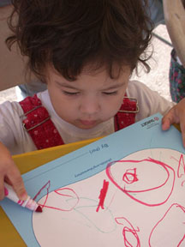
Why teach it?
Geometry is about pictures.
It is accessible.
One of the first abstract activities humans do after they are born is to draw pictures

Slide 20
Why teach it?
Pictures are helpful to people who prefer non-verbal learning.
Geometry can make other areas of mathematics more accessible. For example: algebra

Slide 21
Why teach it?
Geometry helps us develop flexibility in our understanding through application of fundamental knowledge.

Slide 22
Geometry

Slide 23
Geometry

Slide 24
Geometry
Why teach it?
Geometry is used to model the world around us. A view of the roofs of houses quickly reveals triangles, trapezia and rectangles, while tiling patterns in pavements and bathrooms use hexagons, pentagons, triangles and squares.
Builders, tilers, architects, graphic designers and web designers routinely use geometric ideas in their work. Classifying such geometric objects and studying their properties are very important. Geometry also has many applications in art.

Slide 25
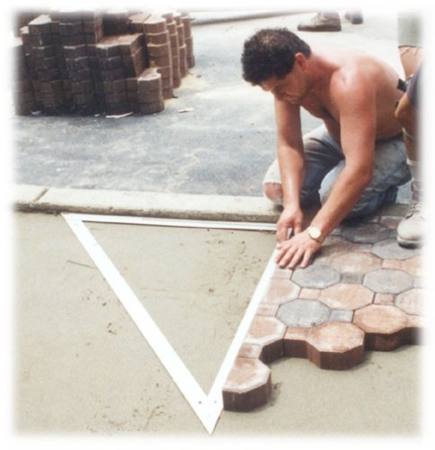
Applications
Building
Pythagoras is used by trades people. Though this topic is taught in junior secondary. for students to begin to grasp ideas about Pythagoras, they need to have developed a solid understanding of primary space and shape ideas.
http://www.amazon.com/gp/product/images/B00004TKDP/ref=dp_otherviews_4/104-6026308-1691933?%5Fencoding=UTF8&s=hi&img=4

Slide 26
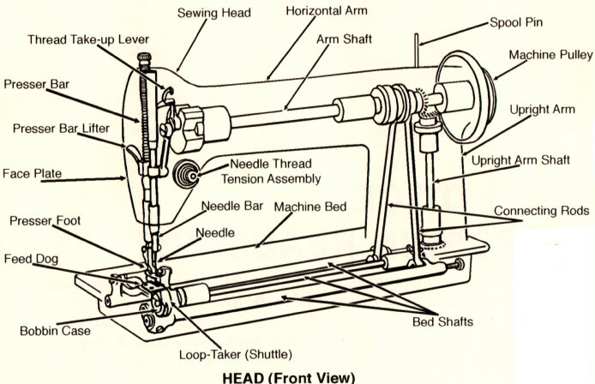
Applications
Mechanics
All mechanical inventions have moving parts that obey the laws of geometry. For example the sewing machine is an application of line segments and points, where one of the points moves around the circumference of a circle.
http://www.amazon.com/gp/product/images/B00004TKDP/ref=dp_otherviews_4/104-6026308-1691933?%5Fencoding=UTF8&s=hi&img=4

Slide 27
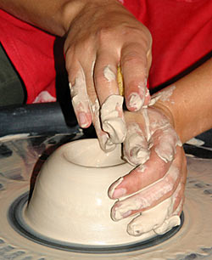
Applications
Art
Throwing a pot is all about symmetry.
A potter wants to know how to find the centre of a circle - exactly!
www.joepicassos.com/ potters_wheel.html

Slide 28
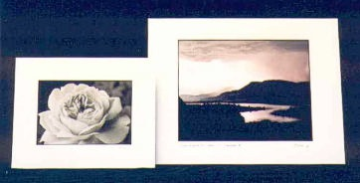
Applications
Scaling and similarity
Enlarging photographs
www.livingartsphotogallery.com/ pricelist.shtml

Slide 29
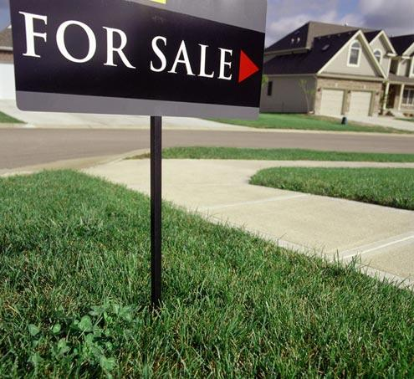
Applications
A Real Estate Agent once asked a mathematics department how to calculate the area of a block of land knowing only the length of the four sides.
Can this be done?
www.tarapolley.com/ Sellingyourownhome

Slide 30
Applications
Land and money: the Toorak example
How much is a strip of land one foot wide down the length of a property worth?

Slide 31
History of Geometry
All the classical civilisations – Egypt, Babylon, India and China had a practical geometry but none treated geometry as a deductive science.

Slide 32
History of Geometry
The papyri, clay tablets and other written material that have come to us invariably state problems in numbers and solve them by recipes.

Slide 33
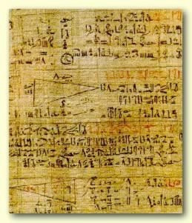
History of Geometry
The Rhind papyrus which dates from about 2000 BC, some 17 centuries before Euclid gives the method of finding the area of a triangle.
http://www.touregypt.net/featurestories/numbers.htm

Slide 34
History of Geometry
In Egypt, the rope pullers were important members of Egyptian society.
They used ropes to form rectangular shapes and right angled triangles.

Slide 35
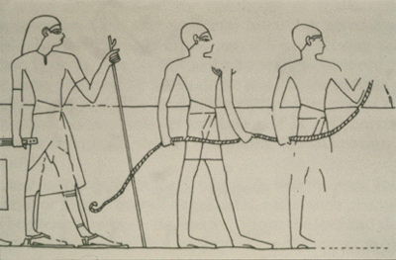
History of Geometry
This picture is from the tomb of a high priest.
www.math.dartmouth.edu/. ../unit1/INTRO.html

Slide 36
History of Geometry
It took 1500 years before the Greeks devised a logical system that enabled them to demonstrate, on very general assumptions many of the geometric results which had been used in special cases by the earlier civilisations.
Students should not become impatient if they do not immediately understand the point of geometrical argument.
Entire civilisations missed the point altogether.

Slide 37
History of Geometry
Euclid’s Elements was written in about 300 BC.
The Elements begins with definitions and five postulates that have come to define much of the geometry we know today.

Slide 38
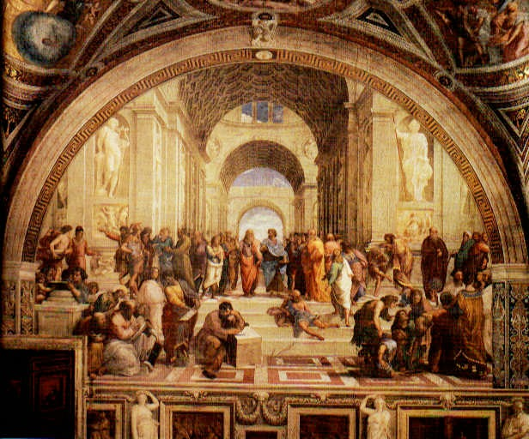
History of Geometry
Raphael’s School of Athens (1509 - 1510)
http://www.christusrex.org/www1/stanzas/Aw-Athens.jpg

Slide 39
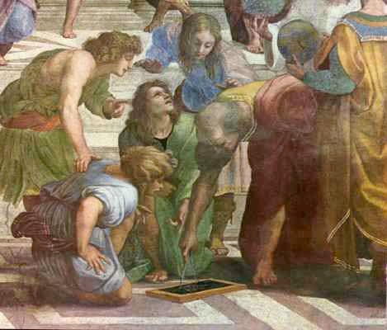
History of Geometry
Detail from School of Athens showing Euclid
(after Bramante - architect.
http://www.christusrex.org/www1/stanzas/Ad-Euclid.jpg

Slide 40
History of Geometry
The renaissance produced a renewed interest in the work of the Greek geometers.

Slide 41
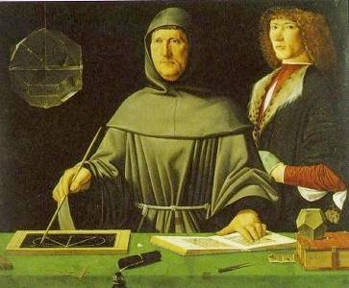
History of Geometry
This painting by
Jacopo de Barbari was painted in 1495.
See the beautiful
Rhombicuboctohedron.
http://www.math.nus.edu.sg/aslaksen/teaching/math-art-arch.shtml

Slide 42
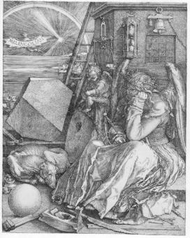
History of Geometry
Dürer’s Melancholia (1514) had mathematical and, in particular, geometric themes.
http://www.math.nus.edu.sg/aslaksen/teaching/math-art-arch.shtml

Slide 43
History of Geometry
Leonardo da Vinci produced the following drawings for a book by Luca Pacioli (1509).

Slide 44
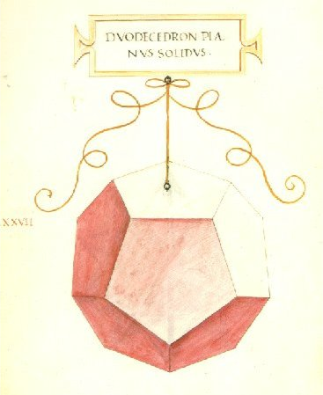
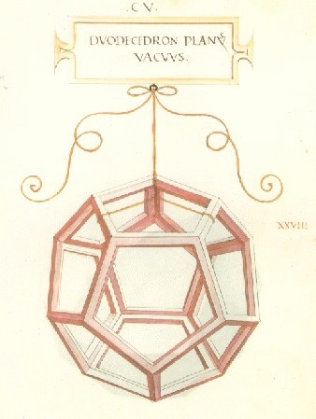
History of Geometry
http://www.georgehart.com/virtual-polyhedra/leonardo.html

Slide 45
History of Geometry
This is a terrific website:
Art and Mathematics
http://www.math.nus.edu.sg/aslaksen/teaching/math-art-arch.shtml

Slide 46
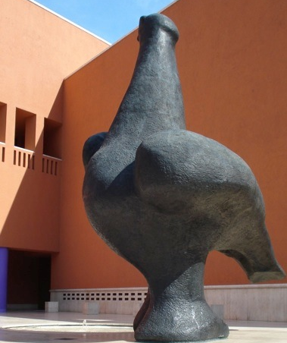
Language

Slide 47
Language
Technical language is used in order to be precise and accurate in the description of spatial ideas
Technical terms should be defined carefully

Slide 48
Language
Use of technical terms. Teachers should
have a clear understanding of these terms;
not underestimate students’ ability to recognise and use terms;
show discretion in using them with students;
supplement terms with informal but accurate language;
ensure geometry teaching does not degenerate into merely learning lists of technical terms

Slide 49
Geometry
Introducing...
Points
Lines
Planes
Angle

Slide 50
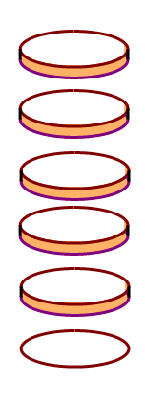
Geometry
The Difference Between
Physical Objects
Diagrams
And
Geometric Concepts

Slide 51
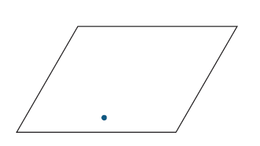
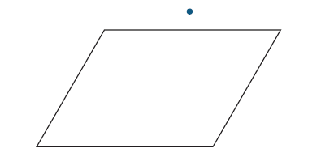
Geometry
Points, lines and planes
Points
Given a point and a plane, there are two possibilities:
The point lies on the plane. The point does not lie on the plane.

Slide 52
Geometry
Points, lines and planes
• Lines go on forever
• When we say line in mathematics, we mean straight line not squiggles and curves
• When we draw a line like this
it is really a line segment

Slide 53
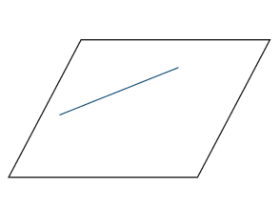
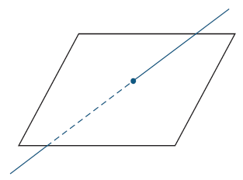
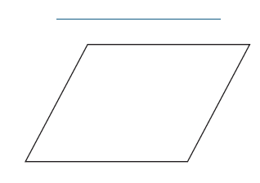
Geometry
Points, lines and planes
Given a line and a plane, there are three possibilities:
The line never meets the plane, no matter how far each is extended.
We say they are parallel.
The line meets the plane at a single point.
We can think of the line passing through the plane.
The line lies
completely
within the plane.

Slide 54
Geometry
Points, lines and planes
Parallel lines
• never meet
• go on forever
Students have an intuitive understanding of parallel
Need to discuss on informal basis with students.
Parallel implies corresponding angles equal and vice-versa.

Slide 55
Geometry
Points, lines and planes
Perpendicular lines
• meet at 90º
• think of the letter T

Slide 56
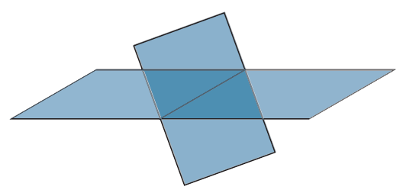
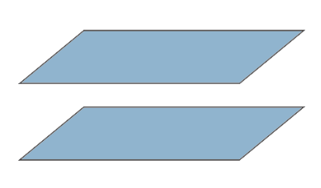
Geometry
Points, lines and planes
Planes
Given two planes, there are two possibilities:
The two planes meet in a line.
The two planes never meet at all, no matter how far they are produced (extended).
We say they are parallel.

Slide 57
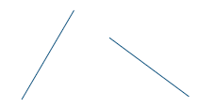
Geometry
Points, lines and planes
Given two lines in space, there are three possibilities:
The lines lie in a single plane and meet in a single point.
The lines lie in a single plane and are parallel.
The two lines do not lie in a single plane. They are skew lines.

Slide 58
Angles

Slide 59
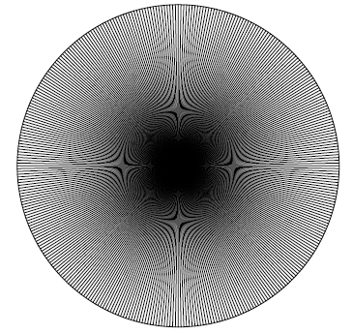
Geometry
Angle
Why are there 360º in a circle?

Slide 60
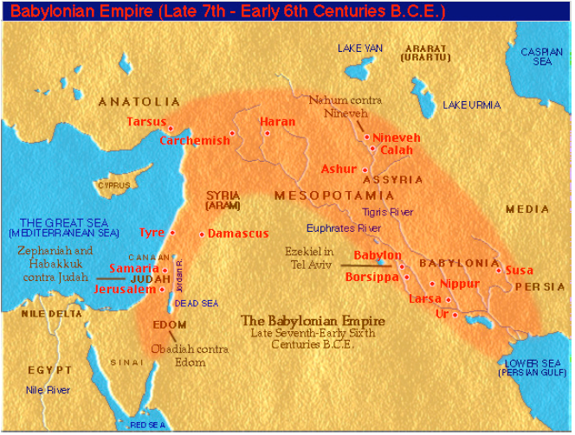
Geometry
Angle
Go back almost 3000 years to Babylonia…

Slide 61
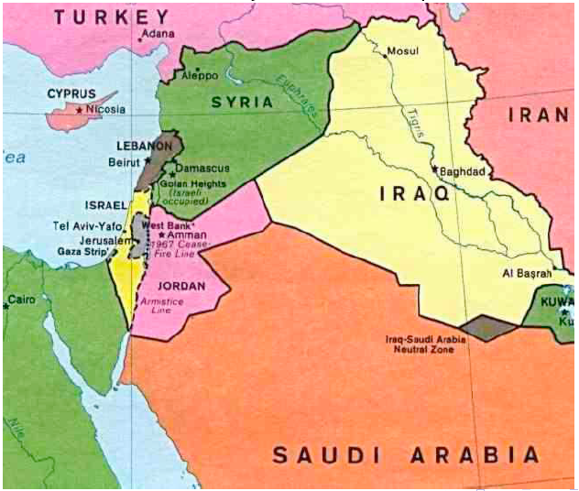
Geometry
Angle
…we call it Iraq.

Slide 62
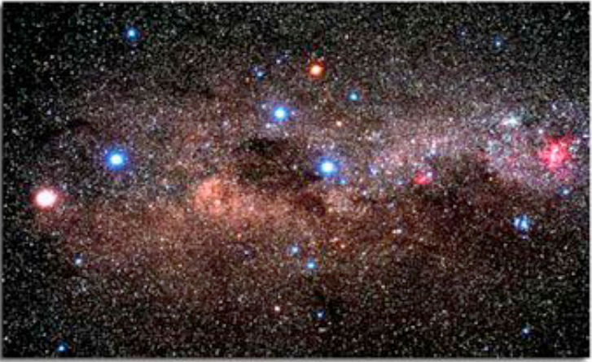
Geometry
Angle
The Babylonians were astronomers.

Slide 63
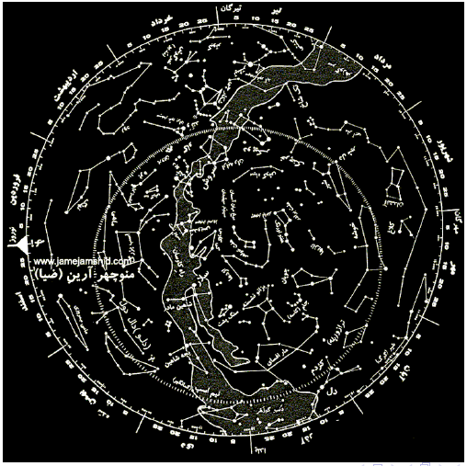
Geometry
Angle
They wanted to know where each star would be tomorrow.

Slide 64
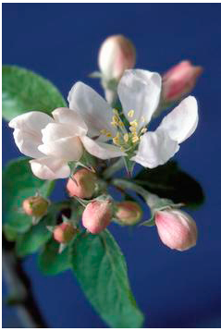
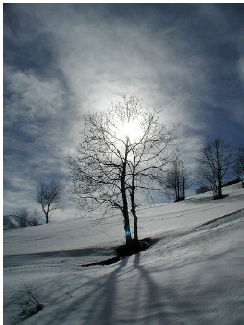
Geometry
Angle
They knew the year was about 365 days long.
If you wanted to calculate the length of the year, how would you go about it?
How long would it take you?

Slide 65
Geometry
Angle
The Babylonians did not use Hindu-Arabic notation and could not deal with fractions which were not of the form .
Try to write in roman numerals to get an idea of the problem.

Slide 66
Geometry
Angle
365 = 5 × 73
So the factors of 365 are 1, 5, 73, and 365.
If you want to divide your cake into slices which are a whole number of degrees you don’t have a lot of choice!

Slide 67
Geometry
Angle
A simplifying compromise…
360 = 2 × 2 × 2 × 3 × 3 × 5
So the factors of 360 are
1, 2, 3, 4, 5, 6, 8, 9, 10, 12, 15, 18, 10, 24, 30, 36, 40, 45, 60, 72, 90, 120, 180 and 360.
They were willing to be out by 5 days in 365 in order to use a number which had lots of factors.

Slide 68
Geometry
Angle
A 3000 year-old model of motion around a circle:
So, there are 360 degrees in a circle because there are 365 days in a year.
This model was useful and well-adapted to the needs of the scientists at the time.

Slide 69
Geometry
Angle
Defining an angle

Slide 70
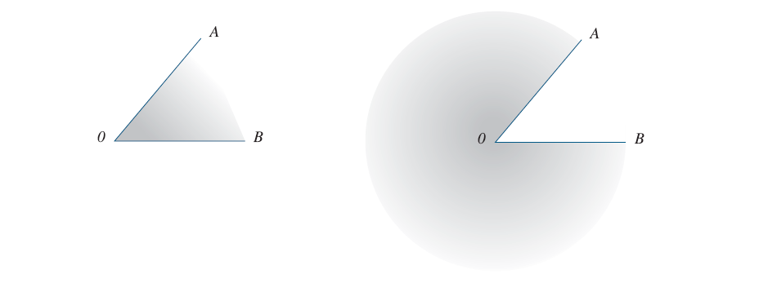
Geometry
Angle
Defining an angle

Slide 71
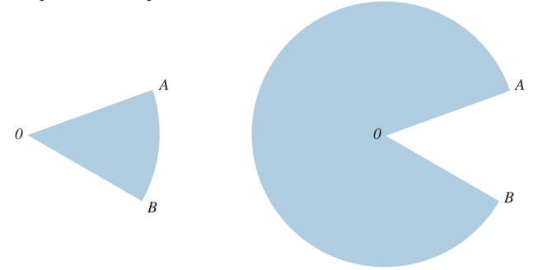
Geometry
Angle
Defining an angle

Slide 72
Geometry
Angle
Measuring angles
Students need a great deal of practise using a pair of compasses and a protractor

Slide 73
Geometry
Angle
Kids in primary school learn about measuring angles before they understand irrational numbers. The most appropriate measure of angle to use at that time in their mathematical development is the degree.
When doing anything other than measuring (eg models of motion involving differentiation), radians behave much more neatly than degrees. When students learn calculus they need to be comfortable with radian measure of angles.

Slide 74
Geometry
Angle
Angle is a measure of an amount of turn.
The amount of turning is called the size of the angle.
The size of the reﬂex angle corresponding to one full revolution was divided(by the Babylonians) into 360 equal parts, which we call degrees.

Slide 75
Geometry
Angle
The size of a straight-angle is 180º and the size of a right-angle is 90º. Other angles can be measured (approximately) using a protractor.

Slide 76
Geometry
Angle
acute (less than 90⁰)
right angle (exactly 90⁰)
obtuse (between 90⁰ and 180⁰)
straight (exactly 180⁰)
reflex (more than 180⁰)

Slide 77
Geometry
Angle
Two angles are complementary if their sum is 90˚
a
b
Two angles are supplementary if their sum is 180˚
a
b

Slide 78
Geometry
Pi

Slide 79
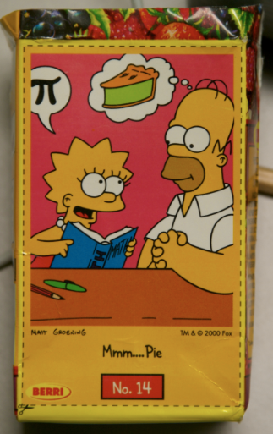
Geometry
Pi

Slide 80
Geometry
Pi
The symbol π is used because it is the first letter of the Greek word , meaning perimeter;
π = 3.1415926535897932384 . . .
Since radius = diameter,
perimeter of circle ÷ radius of circle = 2 π .

Slide 81
Geometry
Pi
The number we call π is irrational.
It can not be written as a fraction and its decimal expansion is infinite and does not recur.
That is why we use a symbol, π , to represent it.
There are no integers a, b such that = π .

Slide 82
Two-dimensional shapes

Slide 83
Types of Triangles
Equilateral
All sides and angles equal (i.e., regular triangle)
Has 3 axes of mirror symmetry
Isosceles
Iso/skeles = equal legs
Two sides equal and angles opposite those sides are also equal
Has one axis of mirror symmetry
Scalene
No sides equal
No axis of mirror symmetry

Slide 84
Types of Quadrilaterals
“Quad” means “4”
quadrilateral is a figure with 4 sides
Parallelogram
Opposite sides parallel
(Derived property: opposite sides equal and opposite angles equal)

Slide 85
Types of Quadrilaterals
Rectangle
Four right angles
(Derived property: diagonals are the same length –this is not true for non-rectangular parallelograms)
We only have to say “four right angles”
“Opposite sides equal” happens automatically
In fact, we need only say “three right angles!”

Slide 86
Types of Quadrilaterals
Rhombus
Four equal sides
Square
Regular quadrilateral
Four sides equal and at least one angle a right angle

Slide 87
Types of Quadrilaterals
Trapezium
Only one pair of parallel sides
Kite
Two sets of two equal sides, with equal sides adjacent
Derived property: diagonals are perpendicular

Slide 88
Types of Quadrilaterals
Use a Venn diagram to show the relationships between the types of quadrilaterals
Parallelograms
Squares
Rectangles

Slide 89
Polygons
A polygon is
a closed, plane figure (that is - 2D) consisting only of straight line segments (sides)
“Many-sided”- though poly/gon means many/angled (“gon” = knee))
Classified according to the number of sides (as before)

Slide 90
Polygon Features
The corners are called vertices (1 vertex, 2 or more vertices)
A line joining one corner to a non-adjacent corner is a diagonal
Note: Don’t say “diagonal line” when you mean “not vertical nor horizontal”
vertex
vertex
vertex
diagonals
vertex
vertex

Slide 91
Polygon Features 3
Polygons can be concave or convex
All the diagonals of a convex polygon lie inside it
A concave polygon has at least one exterior diagonal and one interior reflex angle
convex
concave

Slide 92
Regular Polygons
A regular polygon has
all angles equal AND
all sides equal
60°
60°
Regular
Irregular
60°

Slide 93
Regular Polygons
Equilateral triangle
Square
Regular pentagon
Regular hexagon
Regular octagon …

Slide 94
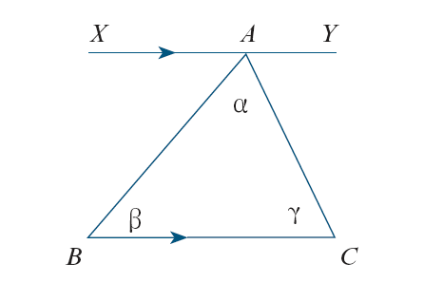
Geometry
Triangles
We can prove the angle sum of a triangle is 180º.
(The first real theorem)
We can apply this to the angle sum of a quadrilateral...

Slide 95
Angle sum
Number of sides | Name | Number of triangles | Angle sum
3 | Triangle | 1 | 1 x 180⁰ = 180⁰
4 | Quadrilateral | 2 | 2 x 180⁰ = 360⁰
5 | Pentagon | 3 | 3 x 180⁰ = 540⁰
6 | Hexagon | 4 | 4 x 180⁰ = 720⁰
7 | Heptagon | 5 | 5 x 180⁰ = 900⁰
8 | Octagon | 6 | 6 x 180⁰ = 1080⁰
9 | Nonagon | 7 | 7 x 180⁰ = 1260⁰
10 | Decagon | 8 | 8 x 180⁰ = 1440⁰
n | Polygon | n-2 | (n-2) x 180⁰

Slide 96
Angle sum
Number of sides | Name | Number of triangles | Angle sum
3 | Triangle | 1 | 1 x 180⁰ = 180⁰
4 | Quadrilateral | 2 | 2 x 180⁰ = 360⁰
5 | Pentagon | 3 | 3 x 180⁰ = 540⁰
6 | Hexagon | 4 | 4 x 180⁰ = 720⁰
7 | Heptagon | 5 | 5 x 180⁰ = 900⁰
8 | Octagon | 6 | 6 x 180⁰ = 1080⁰
9 | Nonagon | 7 | 7 x 180⁰ = 1260⁰
10 | Decagon | 8 | 8 x 180⁰ = 1440⁰
n | Polygon | n-2 | (n-2) x 180⁰

Slide 97
Angle sum
Number of sides | Name | Number of triangles | Angle sum
3 | Triangle | 1 | 1 x 180⁰ = 180⁰
4 | Quadrilateral | 2 | 2 x 180⁰ = 360⁰
5 | Pentagon | 3 | 3 x 180⁰ = 540⁰
6 | Hexagon | 4 | 4 x 180⁰ = 720⁰
7 | Heptagon | 5 | 5 x 180⁰ = 900⁰
8 | Octagon | 6 | 6 x 180⁰ = 1080⁰
9 | Nonagon | 7 | 7 x 180⁰ = 1260⁰
10 | Decagon | 8 | 8 x 180⁰ = 1440⁰
n | Polygon | n-2 | (n-2) x 180⁰

Slide 98
Angle sum
Number of sides | Name | Number of triangles | Angle sum
3 | Triangle | 1 | 1 x 180⁰ = 180⁰
4 | Quadrilateral | 2 | 2 x 180⁰ = 360⁰
5 | Pentagon | 3 | 3 x 180⁰ = 540⁰
6 | Hexagon | 4 | 4 x 180⁰ = 720⁰
7 | Heptagon | 5 | 5 x 180⁰ = 900⁰
8 | Octagon | 6 | 6 x 180⁰ = 1080⁰
9 | Nonagon | 7 | 7 x 180⁰ = 1260⁰
10 | Decagon | 8 | 8 x 180⁰ = 1440⁰
n | Polygon | n-2 | (n-2) x 180⁰

Slide 99
Congruent and similar shapes

Slide 100
Congruent Shapes - 1
Two figures are congruent if they have the same shape and size
one figure can be placed on top of the other so that they coincide exactly
may involve : turns, flips and slides

Slide 101
Congruent Shapes - 2
Congruent shapes have
Corresponding angles equal AND
Corresponding sides equal

Slide 102
Congruent Shapes - 3
Just checking angles is not enough

Slide 103
Congruent Shapes - 4
For triangles, just checking sides IS enough
Given three side lengths, there is only one possible triangle
Technique of using a compass to make a triangle

Slide 104
Triangle Inequality
B
A + B > C
A + C > B
B + C > A
C
A
This holds for any triangle:
“The sum of the lengths any two sides of a triangle must be greater than the length of the third side”
Do not confuse this with Pythagoras’ Theorem, which allows us to find the exact length of the missing side of a special triangle (right-angled triangle): A² + B² = C² (where C is the hypotenuse)

Slide 105
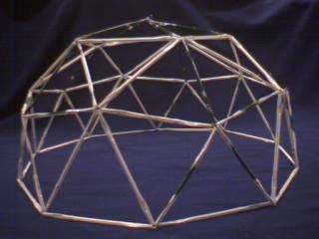
Congruent Shapes - 5
This is what makes triangles rigid and good for strong building in engineering and architecture

Slide 106
Congruent Shapes - 6
For shapes with more than three sides, just checking sides is NOT enough
For quadrilaterals (and shapes with more sides) can make infinitely many shapes given a set of side lengths

Slide 107
Similar Shapes -1
Two figures are similar if they have the same shape, but are not necessarily the same size (side lengths or area!)
corresponding angles are equal
corresponding sides have the same ratio (known as the scale factor)

Slide 108
Similar Shapes - 2
corresponding angles are equal
corresponding sides have the same ratio
38°
38°
longest
middle
94°
middle
longest
48°
shortest
94°
longest
7.5 cm
longest
=
= 1.5
5 cm
48°
shortest
middle
5.5 cm
middle
=
= 1.5
3.7 cm
Scale factor
shortest
4.5 cm
shortest
=
= 1.5
3 cm

Slide 109
Similar Shapes - 3
Similar shapes: Imagine using the photocopier to enlarge or reduce the shape
A setting of 200% is a scale factor of 2, and so the side lengths on the new shape are 2 times those on the original
How would the area of the new shape compare to the original?
A special case of similarity is when the scale factor is 1 (100%), and then we call the shapes congruent.

Slide 110
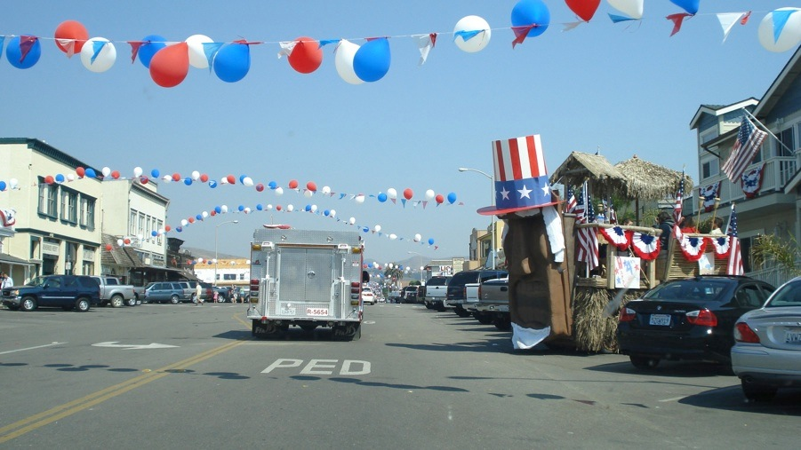
Three-dimensional objects

Slide 111
Talk to the person next to you:
Describe &/ or draw:
a “prism”
a “pyramid”
Describe what is meant by the term “cross-section”

Slide 112
Write down yes or no …
Is a cylinder a prism?
Is a cone a pyramid?

Slide 113
Introduction to Dimensions - I
1 D (1 dimensional) object - a line - has only length

Slide 114
Introduction to Dimensions - II
2D shapes lie flat in a plane
They have “length” and “width”
More technically, we can describe the position of any point on the shape with just two coordinates
y
(4, 2)
x

Slide 115
Introduction to Dimensions - III
3D objects cannot lie in a plane
They have “length”, “width” and “height”
z
(2, 2, 1)
y
x
We need three coordinates to describe the position of any point on the object

Slide 116
Introduction to Dimensions - IV
We live in a 3D world but our perception of it is more 2D. Binocular vision gives an impression of depth, BUT we can’t see around the back of something
Drawings are only 2D representations of 3D objects
Lots of real life 3D shapes including people, chairs, etc!
Educationally we tend to focus on certain conventional objects.

Slide 117
Language
Using correct and appropriate language is very important
As for 2D shapes, properties define solids, not merely that “they look like it”
To talk about properties you need the language

Slide 118
Language - Parts of Solids
Face (try not to say ‘side’!). Only applies to flat surfaces. Names for faces often based on 2D shapes
Angle
Edge
Vertex (sometimes “corner”, plural “vertices”)
Vertex
Edge
Angle
Face

Slide 119
Language - Types of Solids
Prisms and pyramids
Sphere, cylinder, cone, cube
Polyhedron
- 3D shape made of 2D polygonal faces
- Plural is “polyhedra”
- Regular polyhedra (Platonic solids)

Slide 120
Prisms
A solid which has a pair of congruent, parallel faces, joined by rectangular sides (so side faces are rectangles). All cross-sections parallel to the base are congruent to it.
Name determined by the face on the base.
Rectangular prism (cube is special case)
Pentagonal prism
Triangular prism
Hexagonal prism

Slide 121
Pyramids
Polygonal base, triangular faces from each side of the base meeting at the apex. All cross-sections parallel to the base are similar to it.
Name determined by the face on the base.
Triangular pyramid
-tetrahedron is special case when all faces the same
Square pyramid
Pentagonal pyramid
Hexagonal pyramid

Slide 122
Other 3D Solids
Cylinder - Like a prism, but not (why?)
Cone - Like a pyramid, but not (why?)
Sphere - Set of points equidistant from the centre … in 3 dimensions
Cylinder
Cone
Sphere

Slide 123
The Platonic Solids
Platonic Solids or Regular Polyhedra
All faces are just one of the regular polygons
All vertices have the same number of faces around them
Only 5 (known to the Greeks)
Are any of these prisms or pyramids?
Tetrahedron Cube Octahedron Dodecahedron Icosahedron

Slide 124
Euler’s Formula
Solid | # Vertices (V) | # Faces (F) | # Edges (E) | V + F - E
Cube* | 8 | 6 | 12 | 2
Tetrahedron* | 4 | 4 | 6 | 2
Dodecahedron* | 20 | 12 | 30 | 2
Pentagonal pyramid | 6 | 6 | 10 | 2
* Platonic solids
V + F – E = 2

Slide 125
Drawing Solids
Focus on key planar shapes and vertices
Use of “hidden lines”

Slide 126
Nets
Younger children
Cut open cardboard boxes
Construct solids from already existing nets (use cardboard, good glue, and large sizes; or else use pre-made kits)
Start to match nets and solids

Slide 127
Nets
Older children
Predict: Solid ↔ Net Match: Solid ↔ Net
Construct
Predict properties of a solid from its net
Will this make a pyramid?
Which net could make the solid shown?

Slide 128
Theory of learning

Slide 129
The Van Hiele Theory
Developed jointly by Pierre van Hiele and Dina van Hiele-Geldof in the 1950s
Used as a framework for teaching geometry and for considering children’s levels of understanding

Slide 130
The Van Hiele Theory
Level 1: Visualisation/Recognition
Level 2: Analysis
Level 3: Abstraction
Level 4: Deduction
Level 5: Rigour
If you teach at one level, those at lower levels can’t work at it. For example, give Level 1 examples as well as Level 2 when working at Level 2.

Slide 131
Level 1: Visualisation (Recognition)
Figures are identified according to their overall appearance. That is, by their shape, not by their properties. Language is imprecise. Reasoning is dominated by perception. Visual prototypes used to identify figures
Parallel lines “like a door”,
Cube: “like a box, dice”
Angle: “pointy triangle shape”

Slide 132
Level 2: Analysis
Figures identified in terms of their properties
- Figures still seen as wholes, but as a collection of properties rather than as typical shapes
- Properties are independent
Recognises that properties imply certain figures, but does not understand that one property may imply another
- a figure is not a rectangle because it is a square

Slide 133
Students’ Level 2 Descriptions (Pegg, 1995)
“A square has four even sides” (lowest category)
“A square is a four-sided figure with all sides equal and all angles 90˚”
“A rectangle is a four-sided figure with four right-angles and two pairs of parallel sides. The top and bottom are the same but different from the other two”
“Parallel lines are two lines the same distance apart that go on forever and never meet”

Slide 134
Level 3: Abstraction
Relationships between properties of a figure are established
Properties can be used to classify figures hierarchically
a square is a rhombus because it has the properties of a rhombus (plus some extra properties)
Understanding of class inclusion

Slide 135
Level 3: Abstraction
Student language is more sophisticated
E.g., “a square is a rectangle with all sides equal”, compared with:
a square is a sort of rectangle (level 2)
a square is like a rectangle but all sides are equal (level 2)
Students are able to discuss this rationally (i.e., with reasons)

Slide 136
Level 4: Deduction
The role of deduction is understood. Necessary and sufficient conditions are understood and ‘minimum property’ definitions can be given.
- a square is a rectangle with a pair of adjacent sides equal.
- A rectangle is a parallelogram with an angle of 90º.
The need for rote learning is minimised.
Proofs of theorems can be constructed.

Slide 137
Level 5: Rigour
Geometry becomes an abstract study based on systems of postulates/axioms
Students challenge the deductions of Euclidean geometry and look at alternate geometries
E.g., Projective geometry: parallel lines meet at infinity.
Can accept results contrary to everyday experience if the proof is mathematically valid
Not normally expected of school students

Slide 138
Attainment of Levels 1–3
Age parameters are not usually associated with van Hiele levels
Students can have attained Level 1 by age 5 or 6, but may still be at this level at age 14-15
Most children starting school will be at Level 1 and should be able to attain Level 2 by the end of primary school
Very few primary school children reach Level 3

Slide 139
Attainment of Levels 3 & 4
Level 3 should be attained by Year 10
indicates a reasonable grasp of geometry for everyday purposes
Level 4 is an appropriate goal for the end of secondary school (reasonable upper bound)
Only about 25% of 18 year-olds function at Level 4 (Pegg & Faithful, 1993)

Slide 140
Children’s Misconceptions
Many misconceptions about space are ‘learned misconceptions’
Children focus on the wrong characteristics and develop limited or false concepts
Geometrical figures are often presented in standard orientations making it difficult for children to generalise these concepts (i.e., it is a flaw in teaching).

Slide 141
Learned Misconceptions 1
‘It’s not a triangle because it has fallen over’

Slide 142
Learned Misconceptions 2
‘Rectangles lie down’

Slide 143
Learned Misconceptions 3
‘It’s too thin to be a rectangle. Rectangles are about twice the size of a square’

Slide 144
Learned Misconceptions 4
‘a is not parallel to c because b is in the way’
a
b
c

Slide 145
Learned Misconceptions 5
‘But parallel lines have the same length!’

Slide 146
Avoiding Learned Misconceptions
A systematic attempt to avoid the misconceptions that a teacher knows may arise can be very effective

Slide 147
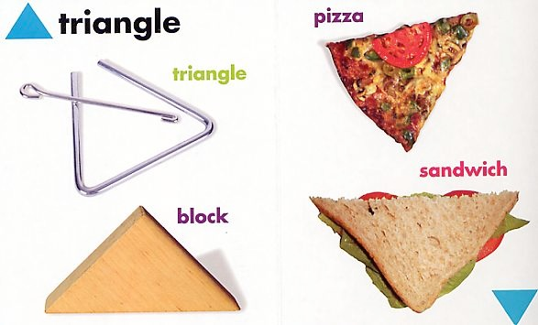
Things to watch for … (I)

Slide 148
Things to watch for … (I)
Not “closed” shape
One curved side
3D object
Sides not straight

Slide 149
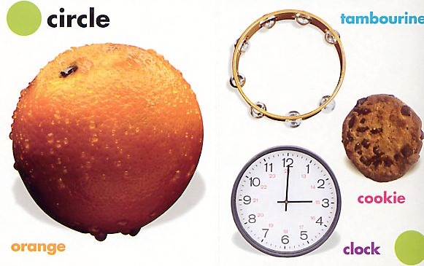
Things to watch for … (II)

Slide 150
Things to watch for … (II)
All 3D objects
Focus on angles here?

Slide 151
Pythagoras
The Pythagorean Proposition Elisha Scott Loomis
Perigal’s Proof: Bill Casselman

Slide 152
Trigonometry

Slide 153
Proof

Slide 154
Proof: EG Circles

Slide 155
We thought…
We said…
We wrote…
We saw…
We heard…
We know…
We drew…
We said…
We asked…
We felt…
We liked…
We learnt…
We didn’t like…
We found out…
We already knew…
We remembered…
We used equipment…
We need to find out…
It was interesting when…
The tricky bit was…
We didn’t know that…
It was cool when…
The important thing to remember is…
A new word we learnt was…
Our group worked well when…
We discovered…
Congratulations to…
The strategy we used was…
Where’s the Maths?

Slide 156
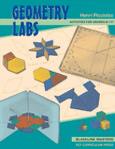
Geometry
Some Suggested Authors
Henri Picciotto –
Objective Learning Materials

Slide 157
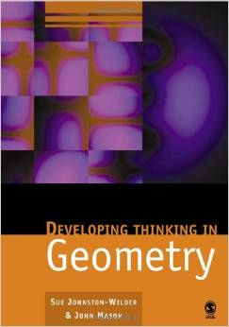
Geometry
Some Suggested Authors
John Mason/ Sue Johnston Wilder

