Slide 1
The Language of Mathematics
“There is significant evidence that many students do not properly grasp the language of Mathematics, which makes learning the subject that much harder for them!”
Melbourne Graduate School of Education
Secondary & University Mathematics, Do they speak the same language?
Communicating Like a Mathematician
Anna Bock: anna.bock@amsi.org.au
Notes:
It is important for all students to be exposed to and learn the language of Mathematics

Slide 2
Aims of the session:
Reflect on insights from your Schools NAPLAN Item Analysis data.
Engage with vocabulary in Australian Curriculum
Explore research based strategies to support student learning of Mathematics vocabulary
Commitment to action
Notes:
Mathematics is a complex body of knowledge that deals with the content strands
Number and Algebra
Geometry and Measurement
Statistics and Probability

Slide 3
Year 3 Item Analysis insights
Subtraction: Difference
Use of altogether, Mental Strategies for Addition & Subtraction
Multiplication & Division
Use of ‘How many more’
Notes:
Many, if not most, NAPLAN items are written in worded form – students need to ‘decode’ what the question is asking. Analysis of NAPLAN responses indicate that many students either incorrectly or partially read the question.

Slide 4
Year 5 Item Analysis insights
Use of ‘How many more’
Equivalent Fractions
Understanding of the remainder
Equation structures: Result unknown, Start unknown, Change unknown
Decimals: Longer is Larger misconception & size of Decimal numbers

Slide 5
What Mathematics vocabulary are we currently using when teaching the four operations?
Teachers to record all the words they have used when teaching:
Addition
Subtraction
Multiplication
Division
Each word is recorded on a post it note
Post it notes are placed under the appropriate headings
Any duplicate words are placed underneath of each other

Slide 6
Have we considered the following vocabulary?
Addition: addend + addend = sum
join together
plus
sum
add
total
increase
make larger
altogether
more than,
in all….

Slide 7
Subtraction: minuend – subtrahend = difference
take away
minus
subtract
make smaller
less than
decrease
compare
difference
What is left?
How many more?
How much more?.....

Slide 8
Multiplication: multiplier x multiplicand = product
multiply
product
groups of
arrays,
rows of
times as many
total
lots of…..

Slide 9
Division: dividend ÷ divisor =quotient
divide
divided by
divided into
shared by
shared into
partition
distribute
How many groups ?

Slide 10
Need for consistency
For example:
5 + 6 = 11
Five and six makes eleven
However,
11 = 5 + 6
Eleven makes five and six ?
Notes:
The language of Mathematics if not used in the same context with the same underlying meaning can result in misconceptions.
At times students may have misconceptions , not that students don’t understand but that they understand in a wrong way.

Slide 11
What Mathematical vocabulary is present in the Australian Curriculum?
Highlight Mathematical vocabulary in the Mathematics overview and achievement standards in :
Number and Algebra
Measurement and Geometry
Statistics and Probability
Notes:
Each teacher is given a content overview from one of the content areas and need to highlight the Mathematical vocabulary in the Australian Curriculum.

Slide 12
Is the Mathematical terminology we are currently using in-line with the Australian Mathematics Curriculum?
Think
Pair
Share

Slide 13
Strategies
Learning Intentions
Need to be explicit in introducing Mathematical vocabulary and yet broad enough to provide access to learning for all students.
For example:We are learning to represent quantities in a variety of ways.
We are learning to partition numbers in a variety of ways.
Repetition/Repetition/Repetition
Whenever a new term is encountered don’t expect the children to know it, understand it and use it straight away; research suggests that a child will typically need to encounter a word 15-20 times before they will start to use it. This is why it is important to use the term at every suitable opportunity.
Maths Walls
Content specific language to unit being taught rather than generic. Students are able to use it as a reference point. Research refers to maths walls as the third teacher. Whenever you encounter new terminology display it on your maths wall for future reference.
Notes:
Allow time to view the various pictures of Maths Walls

Slide 14
Strategies
Dictionaries
Sets in the classroom for student reference .While a definition is useful, new terms must be also understood from meaningful examples and contexts relevant to the student.
Personal maths dictionary
This allows children to keep a personal record of the vocabulary they encounter.
Origin of words
Bi/Duo, Tri, Quad (different words from different regions e.g.. Hept : Greek/ Sept: Latin
Discussions
Opportunities for Mathematical conversations and discussions to share of Mathematical thinking and strategies. Students working in pairs is one way of promoting discussion.

Slide 15
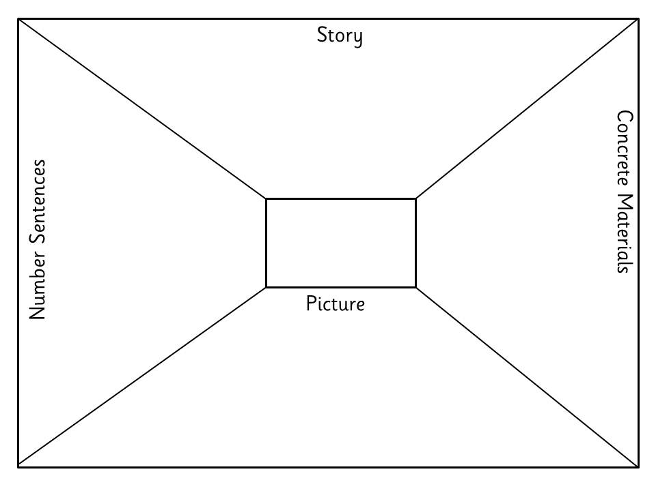
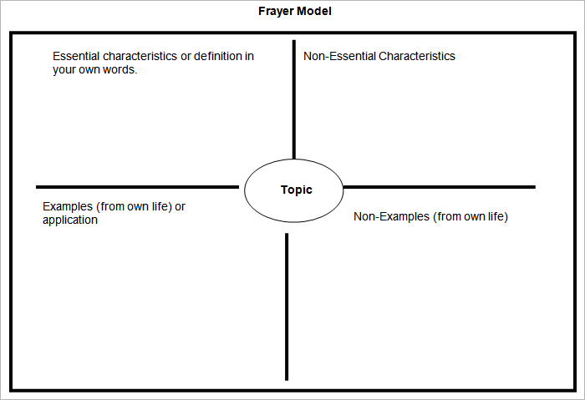
Strategies
Graphic organizers
Think boards, Frayer model

Slide 16
Strategies
Number Talks
Through the regular use of Number Talks the children will begin to appreciate how having a good grasp of the correct mathematical language can help them explain their thinking in a more accurate and efficient way during number talks. Furthermore, he/she will realise that it is easier to understand the approach of a peer when they use terminology that he/she recognises and understands.

Slide 17
Australian Curriculum Glossary
https://www.australiancurriculum.edu.au/f-10-curriculum/mathematics/glossary/?letter=A

Slide 18
Commitment to action….
How will you as an educator, deepen your knowledge as a result of the Professional Learning session?
Some possibilities might be :
Reflect on current planner and the vocabulary documented
Professional reading
Professional conversations with colleagues
Reflecting on practice

Slide 19
References
Benjamin, A., 2011 ,Math in Plain English, Literacy Strategies for the Mathematics Classroom, Eye on Education,Inc.
Reys, R., Lindquist, M., Lambdin, D., & Smith, N., 2009, Helping children learn mathematics, Wiley, USA,189-190.
Swan, P. & Dunstan, D.2018. My Word Book: Mathematics. Picton Press West Perth.
Thompson, D., & Rubenstein, R., (2000). Learning mathematics vocabulary: Potential pitfalls and instructional strategies. The Mathematics Teachers.
www.calculate.org.au
https://sites.google.com/site/primarycpd/latest-news/numbertalks
http://calculate.org.au/wp-content/uploads/sites/15/2017/10/mgse-1-communicating-like-a-mathematician.pdf
https://www.australiancurriculum.edu.au/f-10-curriculum/mathematics/glossary/?letter=A

